Slide 1



EDU-CONSULTANCY SYSTEM
Team 4
Hasini
Sahana
Neerati Rahul
Anjali Krishna
Venkatesh
Rakesh

Slide 2
CONTENT
INTRODUCTION
TECHNOLOGIES USED
IMPLEMENTATION
ADVANTAGES
CONCLUSION
FUTURE SCOPE

Slide 3
INTRODUCTION
The education landscape rapidly evolves, with numerous student options and opportunities.
However, this abundance can often lead to confusion. Traditional methods of consultancy and guidance are time-consuming, lack scalability, and are not always accessible to everyone.
The Edu Consultancy System aspires to create a future where every student has access to personalized guidance and resources, regardless of their location or financial background.
Integrating state-of-the-art technology with education aims to democratize knowledge and opportunity, fostering a world where informed decisions drive academic and professional success.

Slide 4
Its primary focus is to facilitate seamless communication, efficient planning, and effective decision-making in the educational domain.
By integrating modern technologies such as Spring Boot, Angular/React, and AI tools, this platform aims to redefine how educational services are accessed and managed.
This system provides stakeholders with tools to:
Organize training programs for students and professionals.
Offer personalized consultancy services.
Manage educational products and services effectively.

Slide 5
TECHNOLOGIES USED
ANGULAR FOR FORNTEND
SPRING BOOT FOR BACKEND
POSTMAN FOR TESTING THE BACKEND

Slide 6
IMPLEMENTATION
The implementation of the Edu Consultancy System is divided into well-structured modules, each targeting a specific functionality to ensure the platform operates seamlessly.
The system employs a combination of advanced frontend, backend, and database technologies, providing a robust and user-friendly solution.

Slide 7
IMPLEMENTATION PHASES ARE:
Home (Dashboard)
User Authentication and Registration includes admin, student, and parent
forms.
The product
About US
Contact US
Feedback

Slide 8
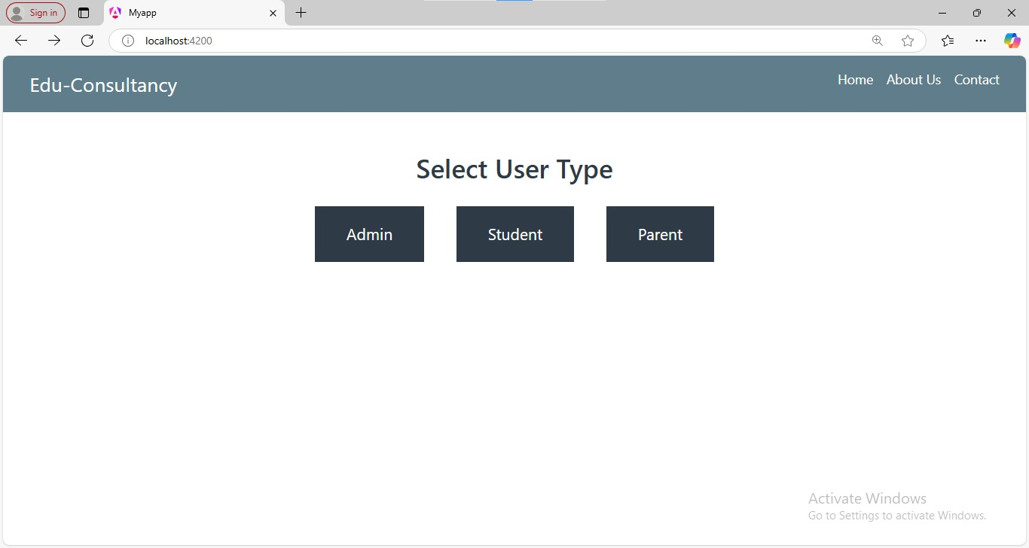

HOME
The Home Page of the system serves as the main interface, where users can select their type (Admin, Student, or Parent) to proceed with the registration process.
It also provides features and services for educational consultancy, catering to the needs of each user type. This page acts as the central hub for navigating the system's functionalities.

Slide 9
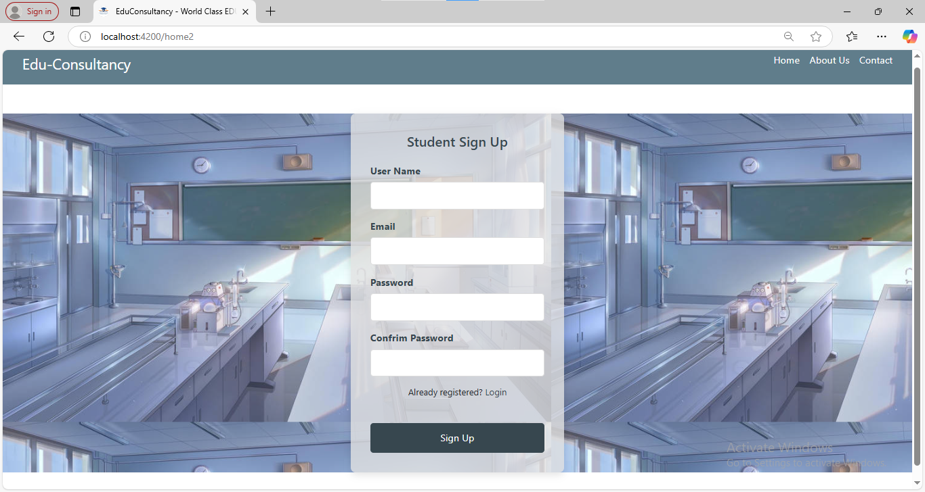
Student sign-up page

Slide 10
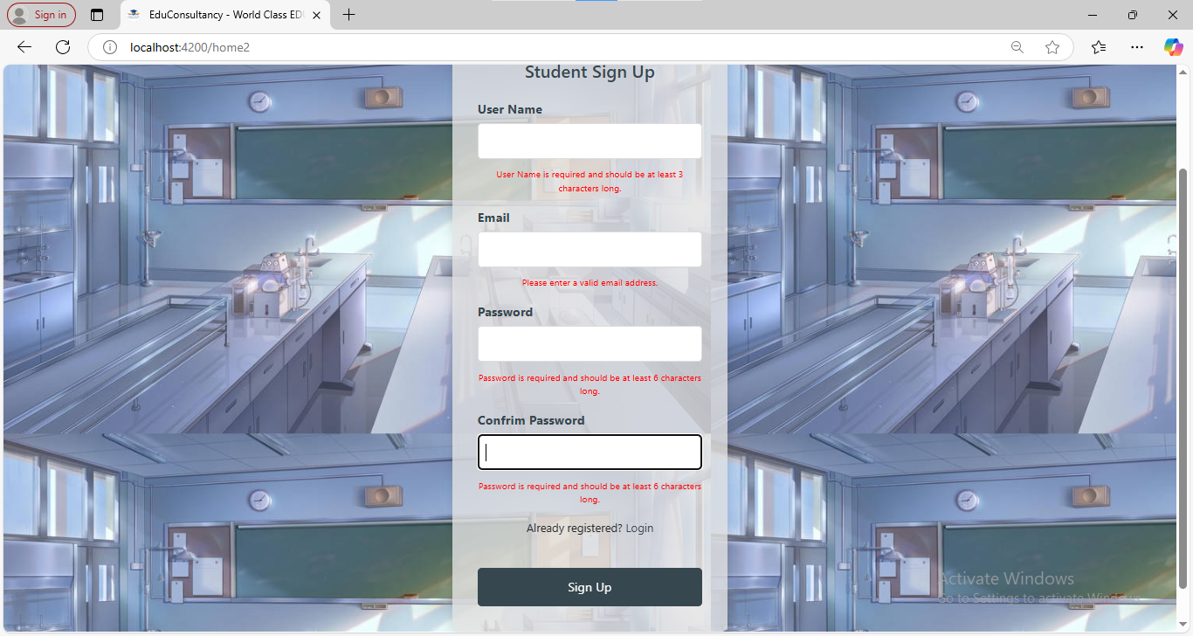
Student sign-up with validation

Slide 11
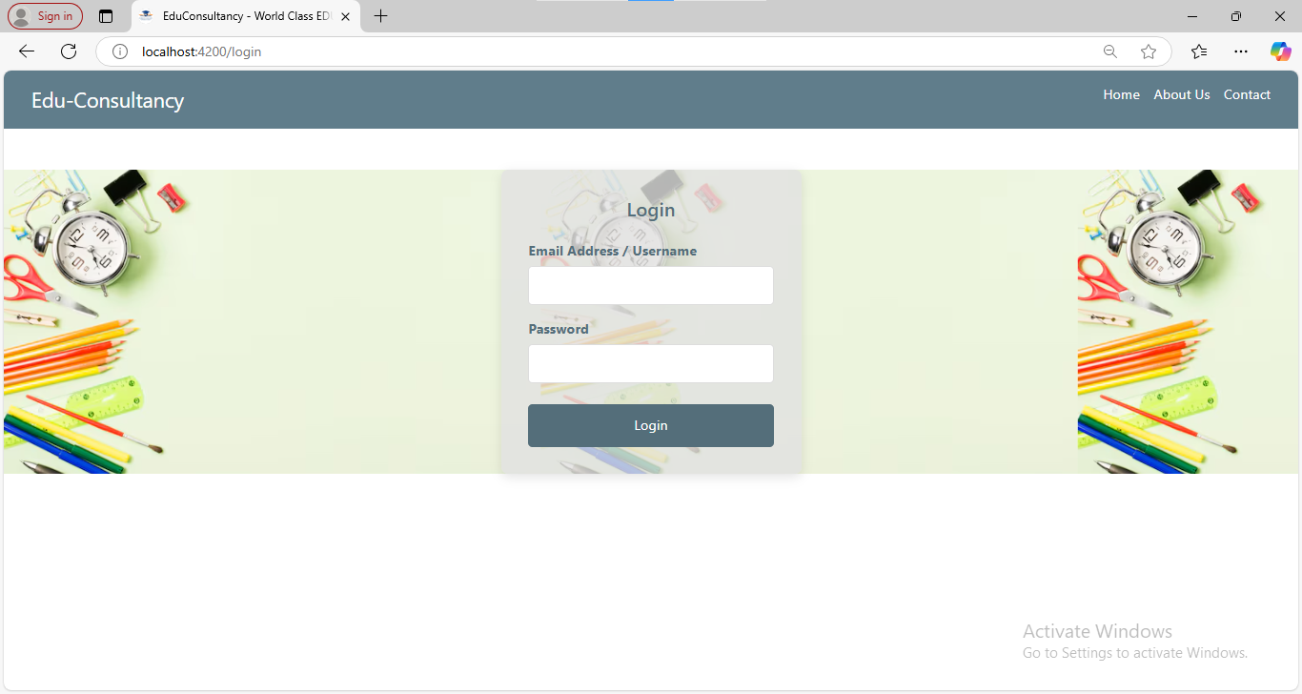
Login page

Slide 12
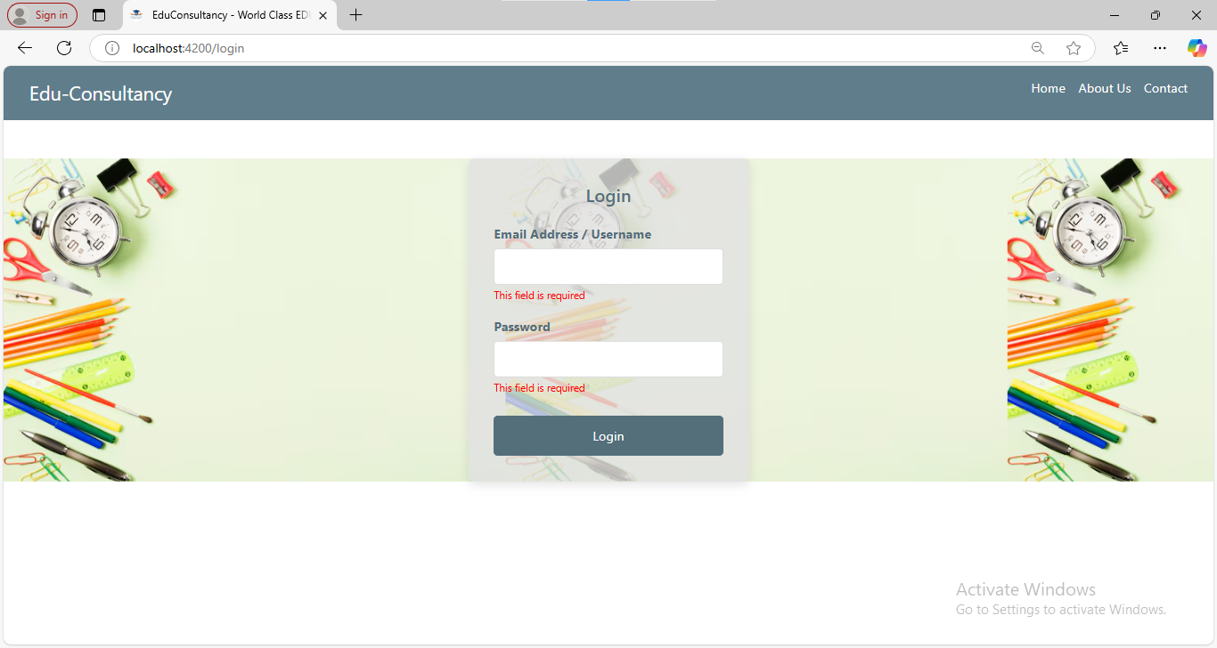
Login page with validation

Slide 13
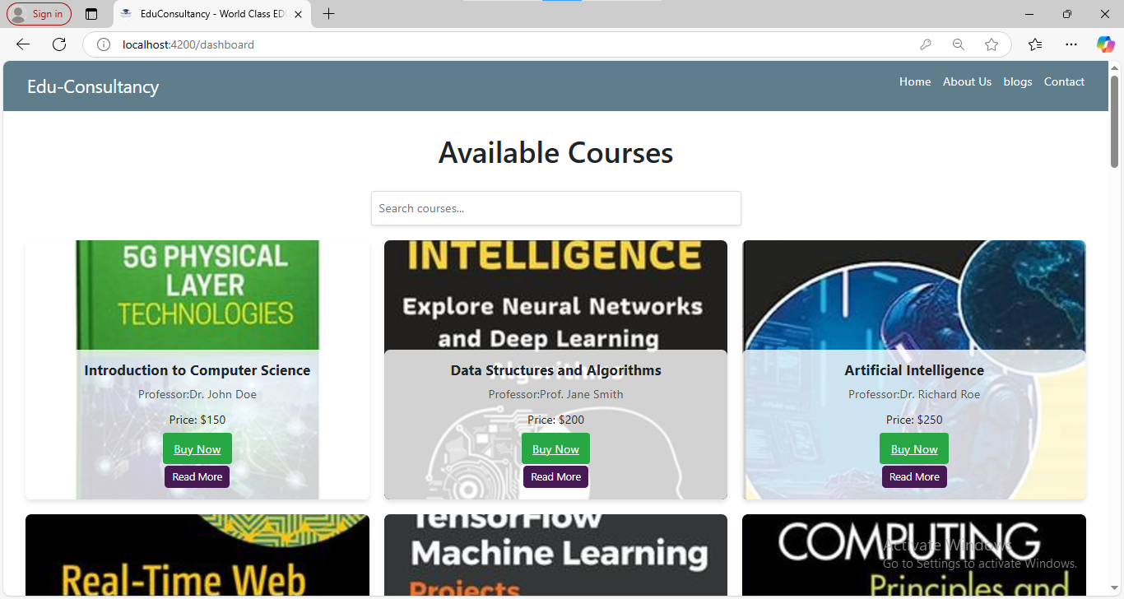
Dashboard

Slide 14
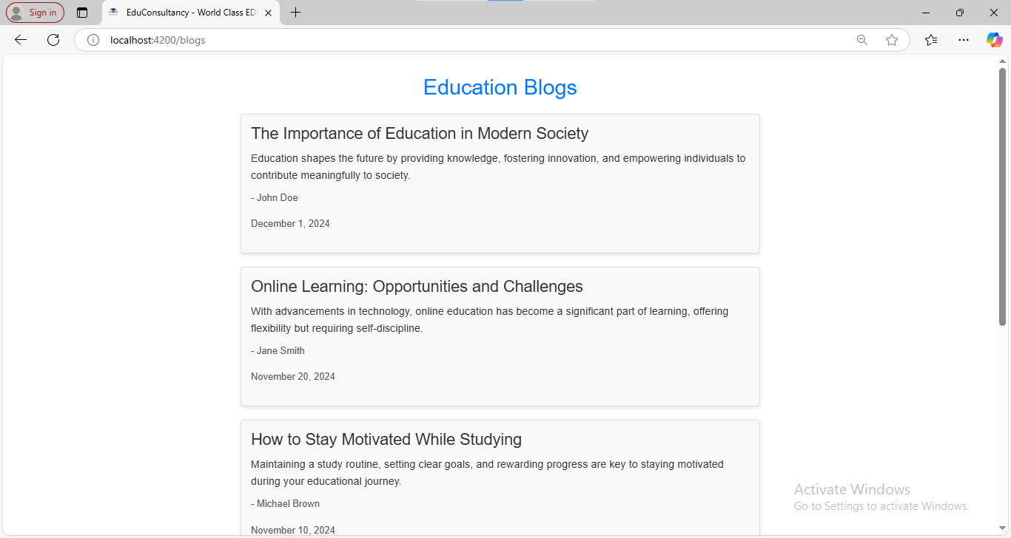
Blogs

Slide 15
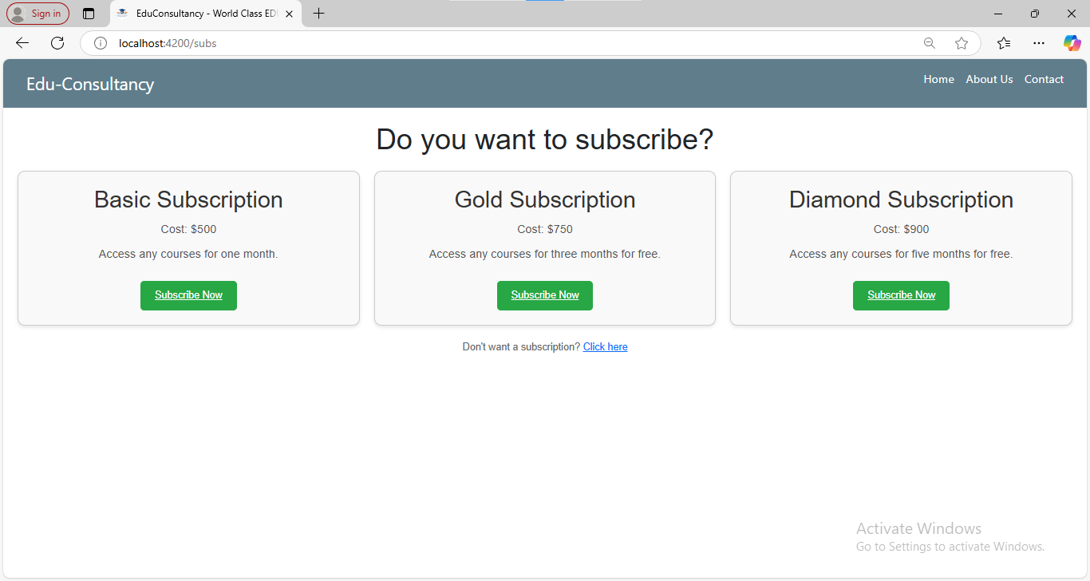
Subscription (or) Payment

Slide 16
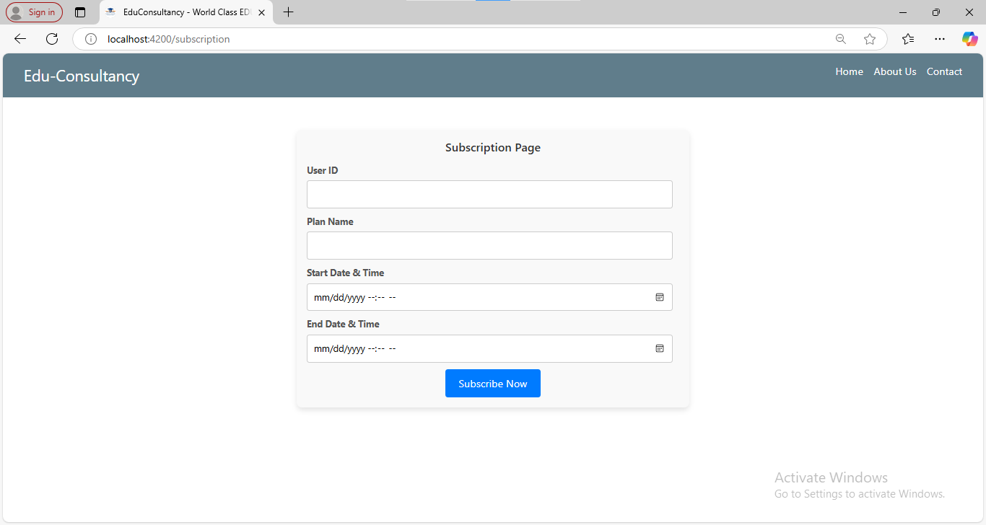
Subscription

Slide 17
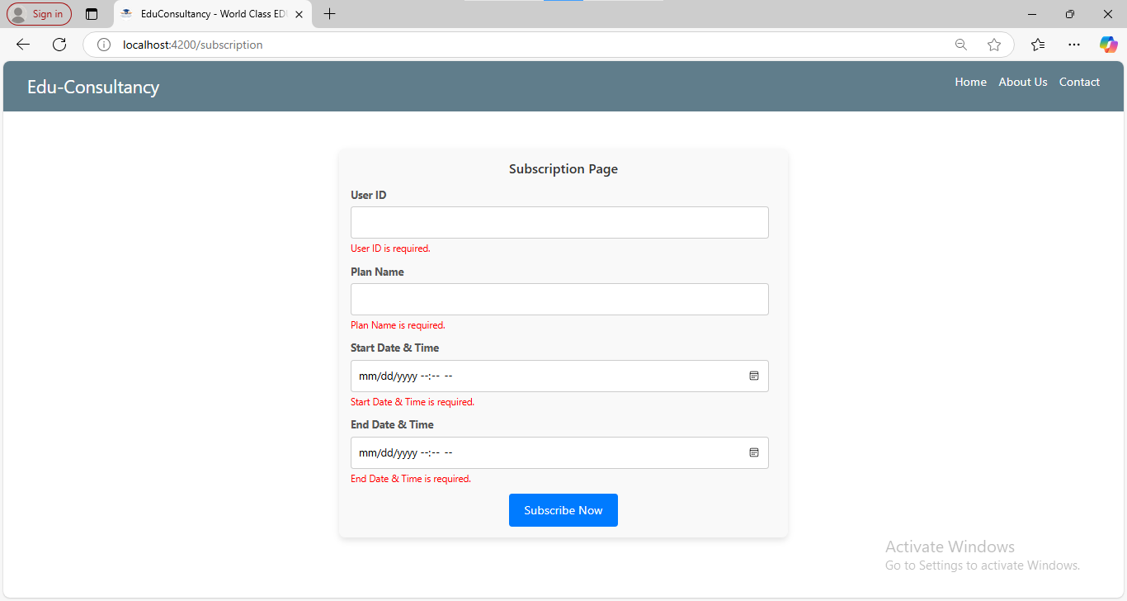
Subscription with validation

Slide 18
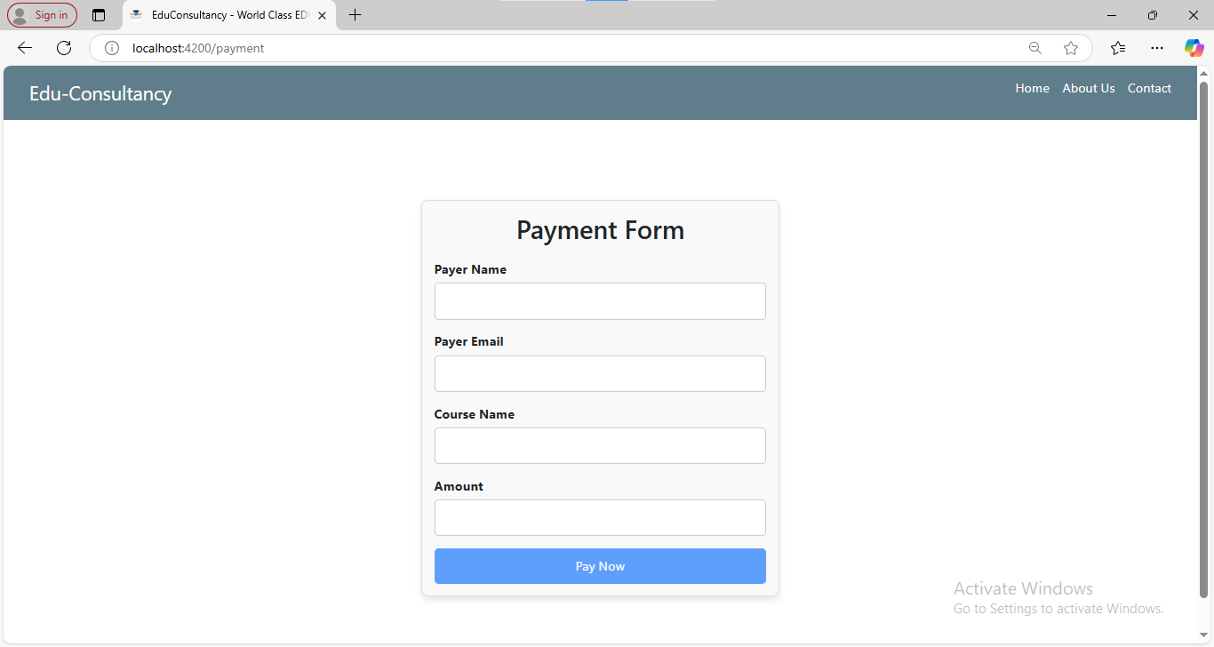
Payment

Slide 19
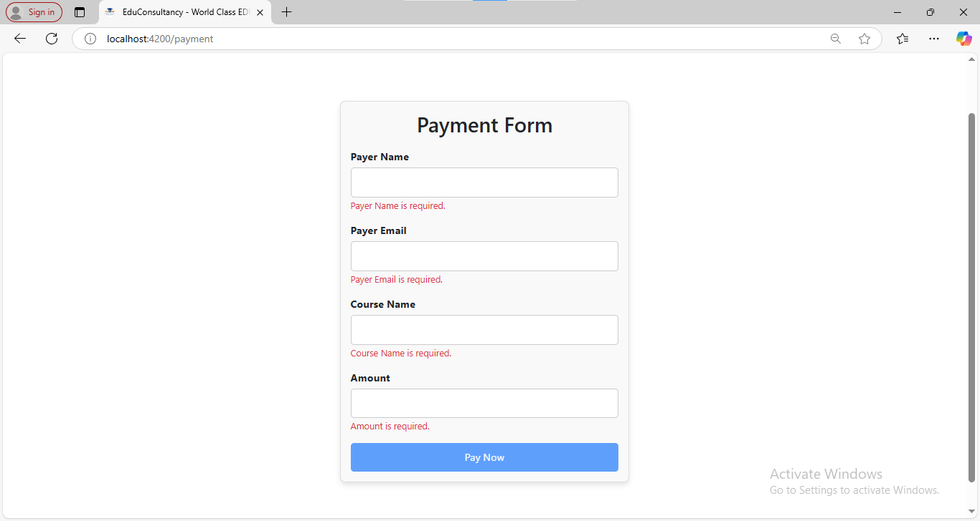
Payment with validation

Slide 20
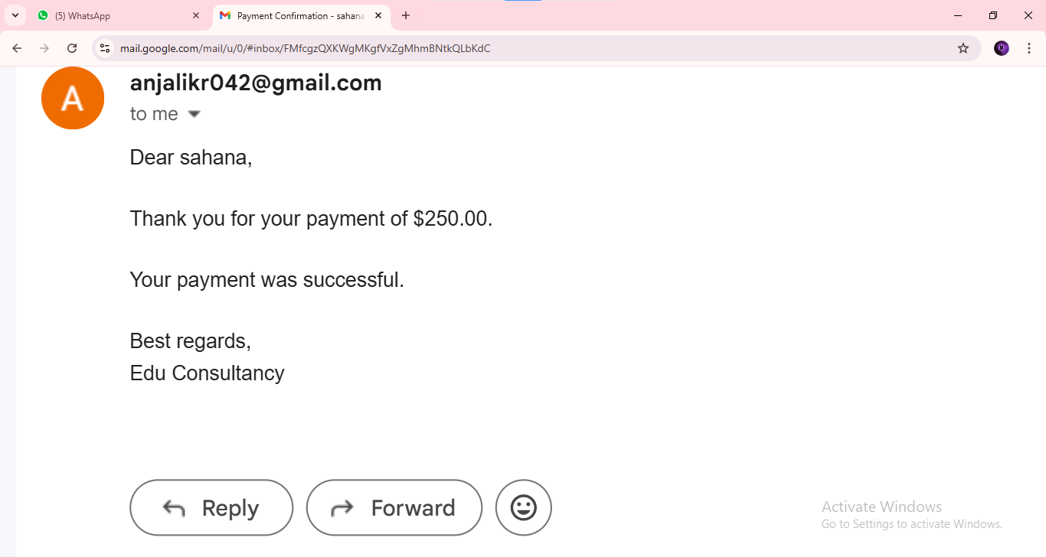
Mail after payment

Slide 21
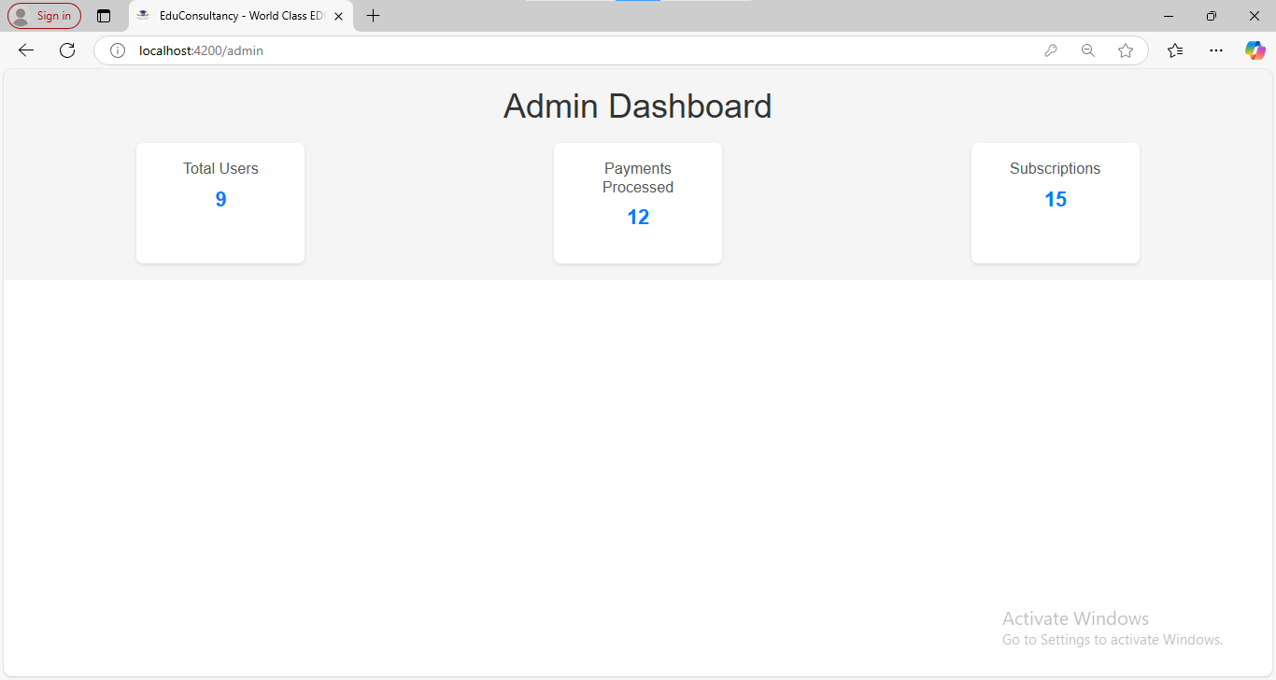
Admin page

Slide 22
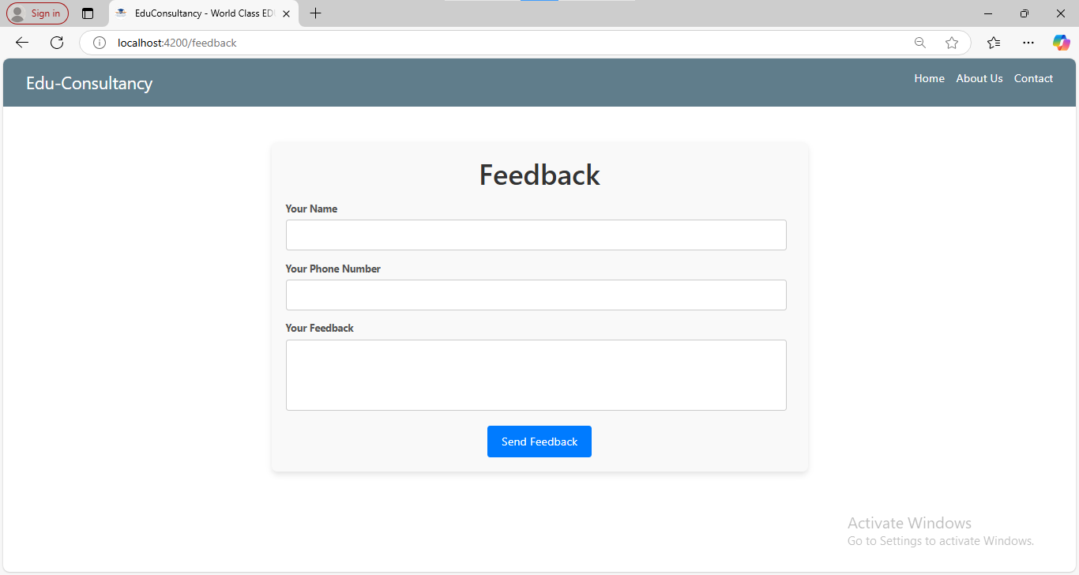
Feedback

Slide 23
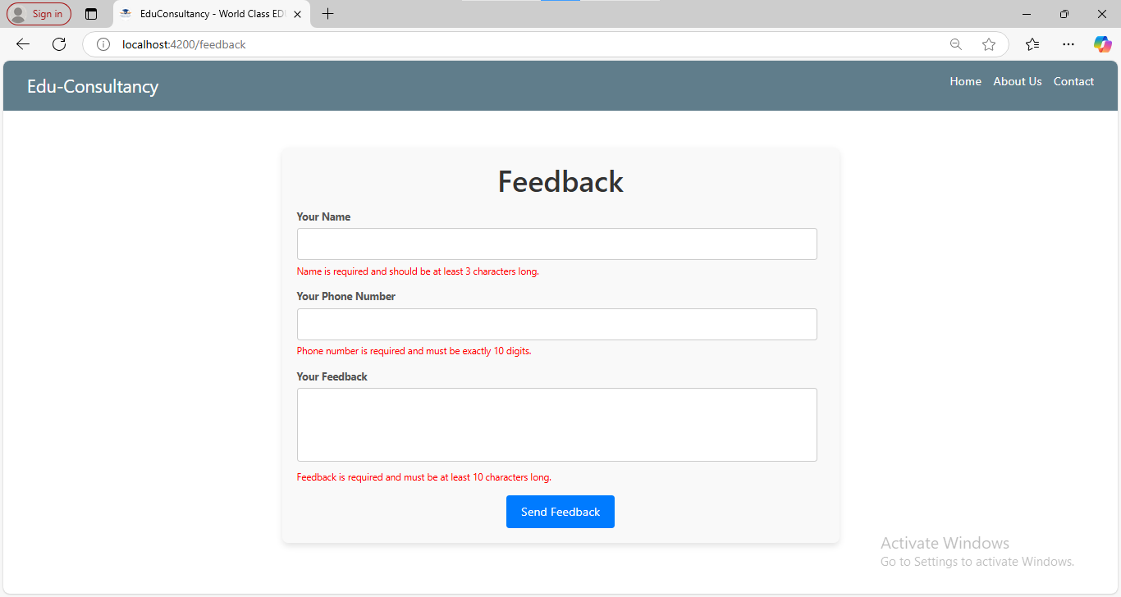
Feedback with validation

Slide 24
ADVANTAGES
Personalized Guidance
Access to Resources
Enhanced Learning Opportunities
Parental Involvement
Administrative Efficiency
Flexibility and Accessibility
Real-Time Solutions Bridging Gaps

Slide 25
CONCLUSION
EDU-Consultancy is a robust platform designed to connect students, parents, and administrators by offering tailored guidance, skills development resources, and seamless communication. It empowers users to make well-informed decisions regarding education and career planning, ensuring access to comprehensive tools and support systems. With its user-focused approach and real-time functionality, the platform effectively meets the dynamic demands of the modern education landscape, fostering growth and success for all stakeholders.

Slide 26
FUTURE SCOPE
Integration with Emerging Technologies
Global Accessibility
Advanced Features
Mobile App Development
Collaboration with Institutions
Sustainability Focus

Slide 27
THANK YOU!

